Slide 1
Speed Dating - Classification Problem
Isaida Shiozawa
Öykü Kenanlı
Special thanks to Filipa Peleja and Guillem Guigo

Slide 2
INDEX
Summary
Data Cleaning
Exploratory Data Analysis
Classification Algorithms
4.a Logistic Regression
4.b Random Forest
4.c Neural Network
Conclusion and Further Analysis

Slide 3
Summary

Slide 4
Summary
In this project, we analyzed the behavior of participants in a speed dating activity using a dataset originally collected for an experiment at Columbia University. Our objective was to build a model that could predict whether or not a couple is likely to make a match. To achieve this, we focused on precision and recall metrics in our models.
One of the main challenges we faced was dealing with a large number of null values and imbalanced data. To overcome this, we utilized imputer models to fill in missing data and explored methods to balance our dataset.
We experimented with three different classification models: Logistic Regression, Random Forest, and Neural Networks. After improving each model, we found that the Neural Network was the best classification model for our problem. Our final model achieved a precision score of 0.84 and a recall score of 0.98 for match predictions.

Slide 5
Summary
What
Challenges
Predictive Models
The success rate is relatively low (Unbalanced data).
Dataset with a range of variables types including text and numerical variables.
Many of the column are incomplete.
Limited number of participants.
Behavior of participants in a speed dating activity using a dataset originally collected for an experiment at Columbia University
Since we want to predict if a couple will match or not, we will work with classification models.
Our objective was to build a model that could predict whether or not a couple is likely to make a match. To achieve this, we focused on precision and recall metrics in our models.
We will need to:
Balance the data
Standardize the variables
Evaluate their usefulness in providing valuable information for our analysis.
Our analysis will involve 3 models:
Logistic regression.
Random forest and
Neural networks.

Slide 6
Data Cleaning

Slide 7
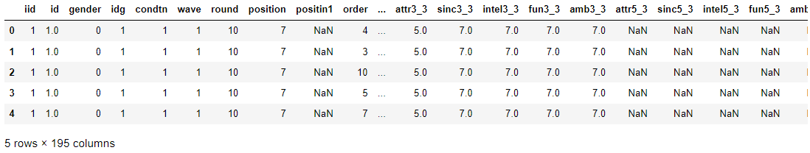
2. Data Cleaning
Our dataset consists of 8,378 rows and 195 columns, with 26% of cells containing null values. Possible reasons for these null values include non-response from participants, data collection errors, and participant disengagement due to the three different points in time when data was collected.

Slide 8
2. Data Cleaning
For cleaning the data we conducted the below steps:
First, finding object data data types and try to convert them to numeric columns if possible
Drop unnecessary columns
Create LDA for university information since we would like to keep it for machine learning algorithms
Use scaler for survey questions to make sure they are on the same page
Separate continuous and categorical columns and impute them with the suitable method
Concat all information together
Notes:
recommendation

Slide 9
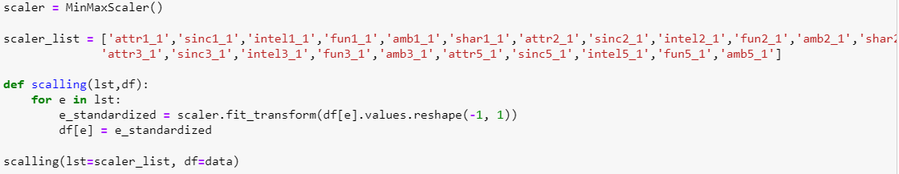
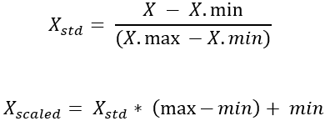
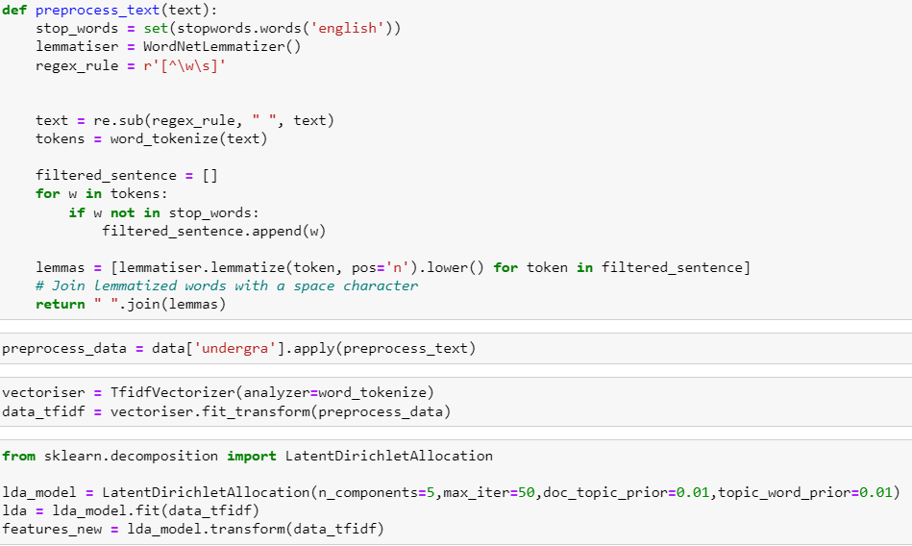
We normalized the data using MinMaxScaler on survey questions because the half of the data evaluated on different scale
We used Linear Discriminant Analysis (LDA) to sort the university info. We tokenized the words and transformed then into 5 new columns.
Notes:
Oyku: I think we can hide these codes and if somebody ask we can show them
Isaida: Link to MinMaxScaler https://scikit-learn.org/stable/modules/generated/sklearn.preprocessing.MinMaxScaler.html

Slide 10
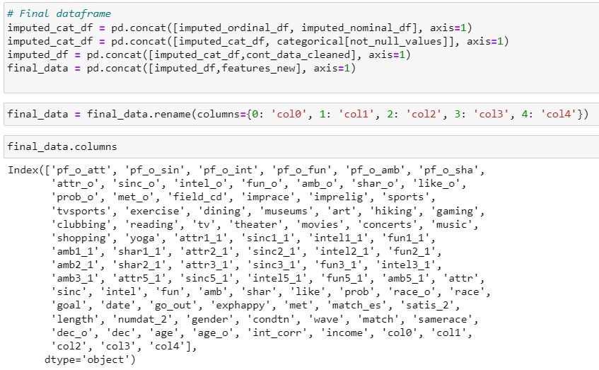
For continuous variables, we used KNNImputer with 5 neighbors
For categorical variables, we used SimpleImputer with most frequent strategy
In the end we had clean data ready! Columns that we are going to use can be seen on the left.
Notes:
Oyku: I think we can hide these codes and if somebody ask we can show them

Slide 11
Exploratory Data Analysis

Slide 12
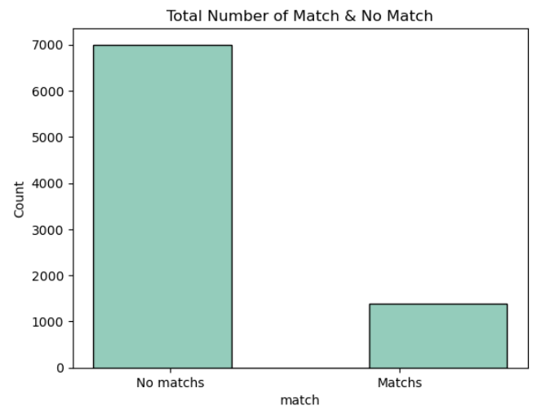
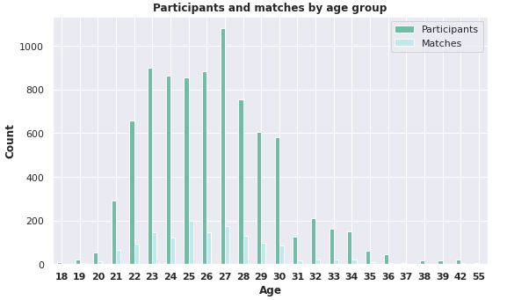
3. Exploratory Data Analysis
The most of the people are between 18 and 30. These ages are also the most likely to have a match.
In our EDA, we also see when the age differences increase, the match possibility is decreasing.
We can see we have a unbalanced data with only 16% of match
Notes:
show age and age match with cont. graphs - 2 graphs, had to keep it as bars because is a mess if I do a scartters or lines plots (it start creating polynomials)

Slide 13
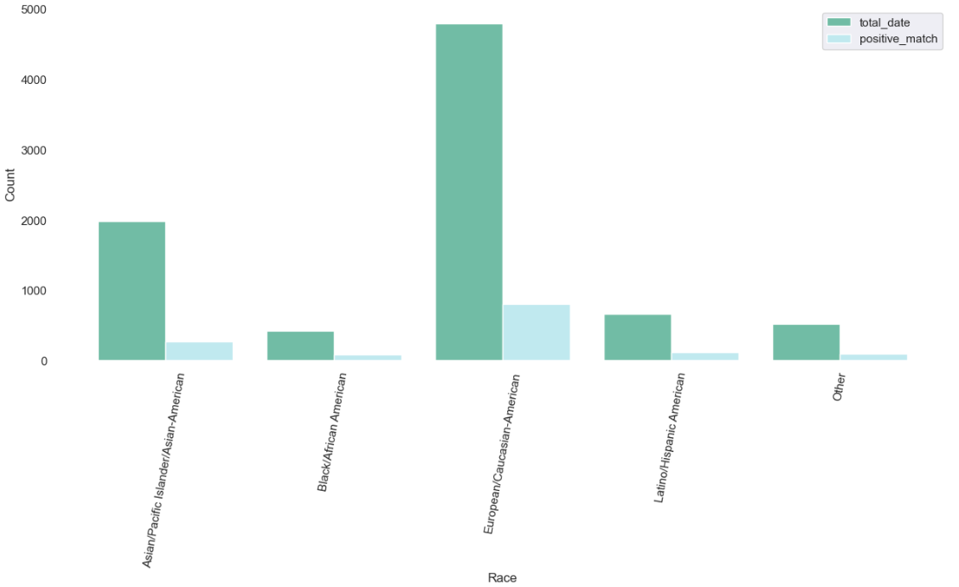
3. Exploratory Data Analysis
- Most of the participants in this experiment are European.
- The group with the highest positive match percentage is Black/African American at 20%, but the total number of participants in this group is too low to generate a reliable statistic.
- For Asian/Pacific Islander/Asian-American participants, even though they are the second biggest group, their positive match percentage is lower than other groups.

Slide 14
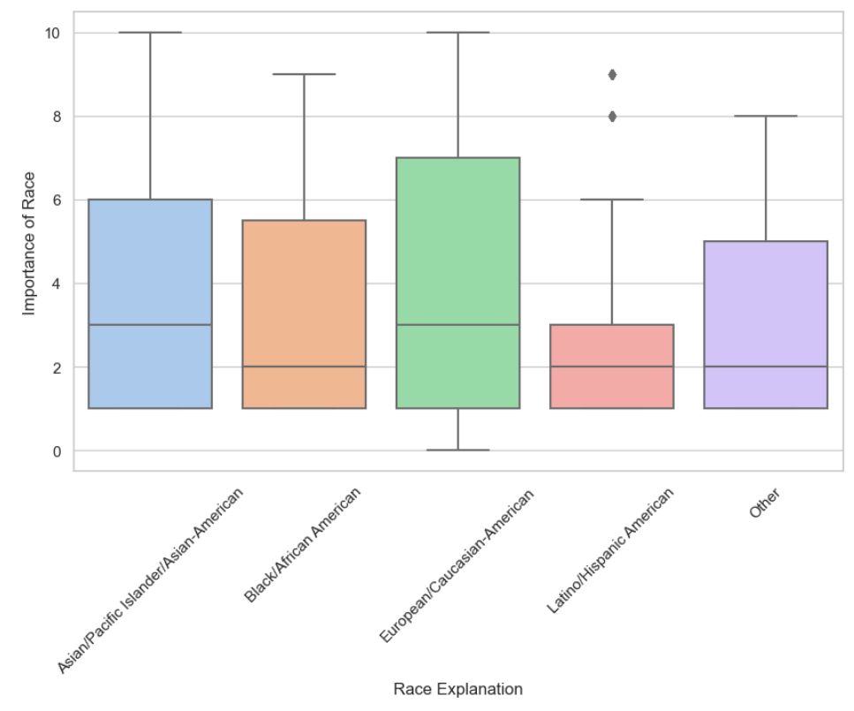
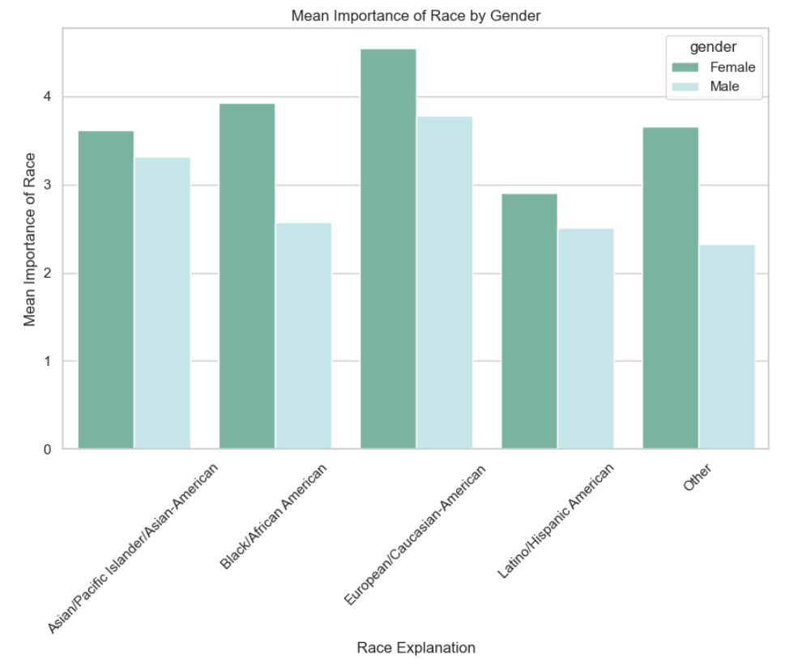
3. Exploratory Data Analysis
Race appears to be more significant for females and Europeans than for other groups.
Although the mean score is not significantly high for Asians, there is still a noticeable difference with 10 points.
On the other hand, for other racial groups, race does not seem to play a significant role.
Notes:
Oyku: I will check descriptions and update this page with written info

Slide 15
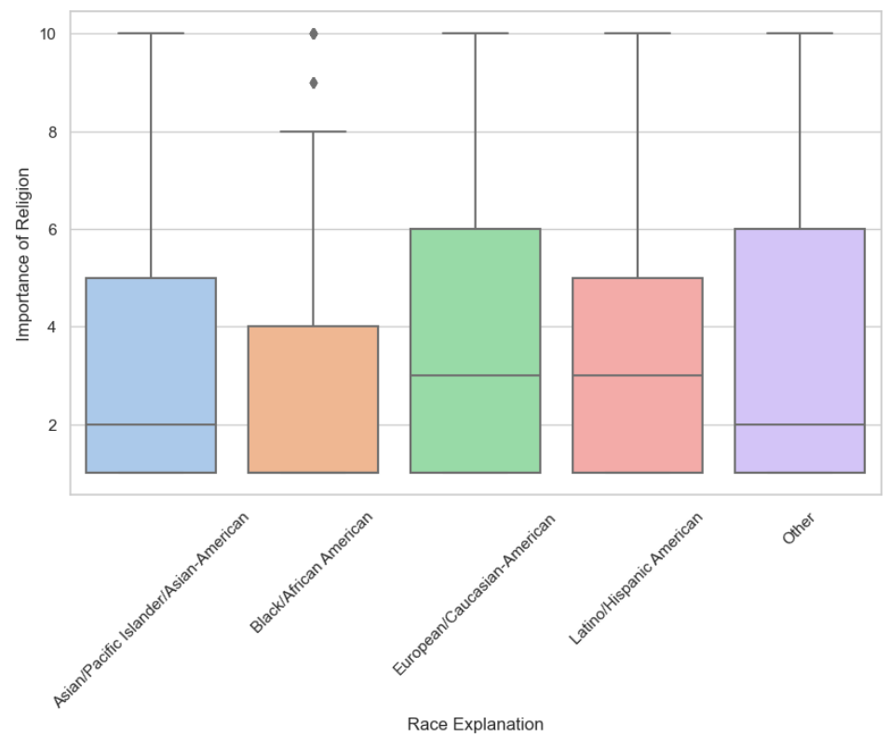
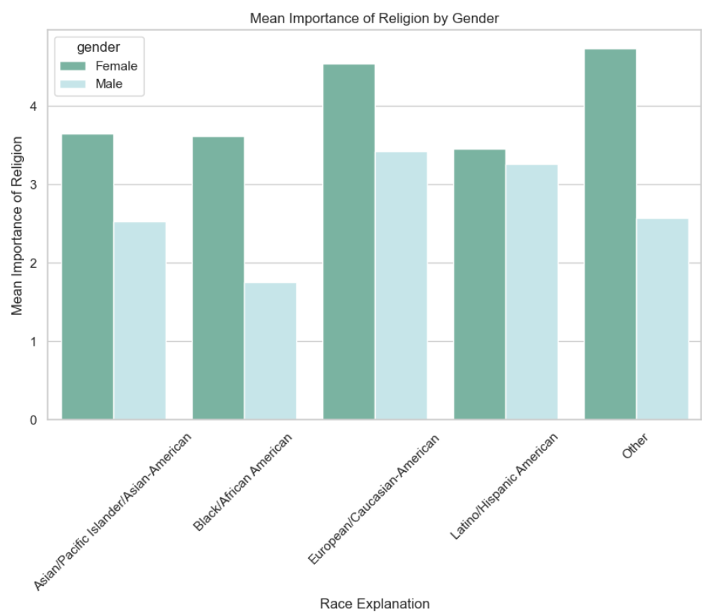
3. Exploratory Data Analysis
Religion appears to be more significant for females, Europeans, and Latinos than for other groups.
While males from Other racial groups have a relatively low level of importance placed on religion, it is of high importance to females in those groups.
The lowest level of importance placed on religion is observed among Black/African American.
Notes:
Oyku: I will check descriptions and update this page with written info
Isaida: I would use pink and blue to differentiate female and males easily

Slide 16
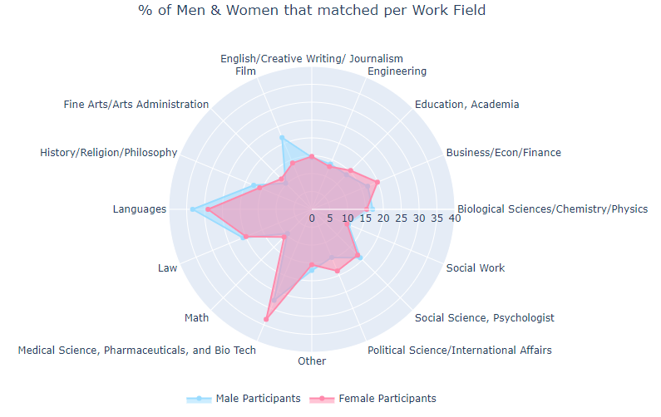
3. Exploratory Data Analysis
Both groups are doing kind a similar
People who work in medicine or language-related fields tend to perform really well, regardless of their gender.
Men seem to do particularly well in the film industry, while women often shine in finance or politics.
While it seems that people who work in social work and math might struggle a bit more with performance.
Notes:
The first sentence will be updated

Slide 17
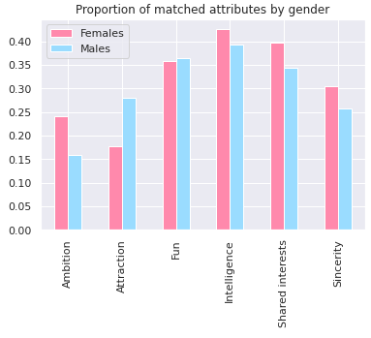
3. Exploratory Data Analysis
When we compare the attributes we can see:
Men tend to place more importance on physical attraction, but they actually score highest in intelligence.
Women, on the other hand, prioritize sincerity, intelligence, ambition, and common interests - with intelligence being the most important quality overall.
Interestingly, both men and women rate a sense of humor or fun as an important trait in a partner.
Notes:
Change the color of the graph similar to the other graphs

Slide 18
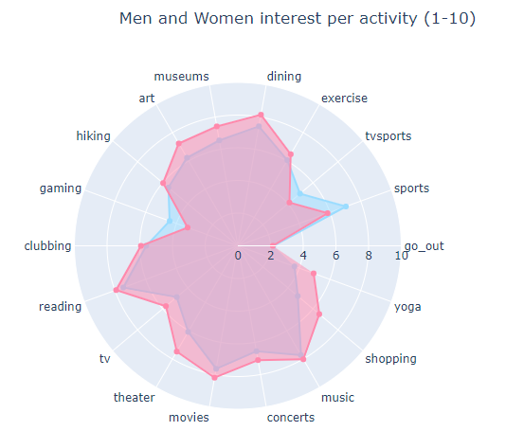
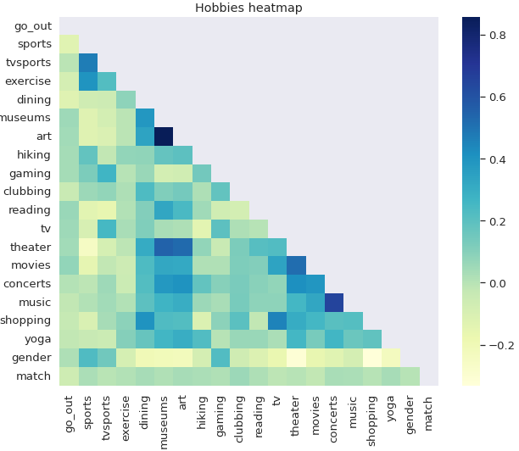
3. Exploratory Data Analysis
Women tend to enjoy activities like dining out, visiting museums, appreciating art, watching TV and theater shows, going shopping, and practicing yoga.
Men, on the other hand, are more likely to be interested in sports, watching TV sports, and playing video games.
Both men and women share similar tastes in activities such as hiking, exercising, reading, going to clubs, watching movies, listening to music, and going out.
Notes:
Heatmap will be updated

Slide 19
Main conclusions from EDA.
Although only 16% of the sample matches, these individuals tend to share common interests and activities. Moreover, marked differences are observed between the fields of study of the matched individuals. In general, the matched individuals prioritize selecting a fun partner with whom they share common interests.
The age differences is also an important factor for match decision. Even though it is higher for some racial groups, importance of religion or race don’t look like have a great impact on the decision.

Slide 20
Machine Learning

Slide 21
4.a Logistic Regression
Logistic regression is a statistical method used to analyze the relationship between a binary outcome variable and independent variables.
1.Assigning outcome variable y and independent variables X
2. To prepare for model training and evaluation, we divided the dataset into three parts: train, test, and validation. We trained our model on the train data, improved it on the validation data, and evaluated it on the test data once we were confident in its performance.
To ensure that the distribution of the unbalanced 1 and 0 labels remained consistent across all three datasets, we used the stratify parameter with both y and y_test. The stratify parameter is a way to make sure that the distribution of different types of data remains the same across different datasets.

Slide 22
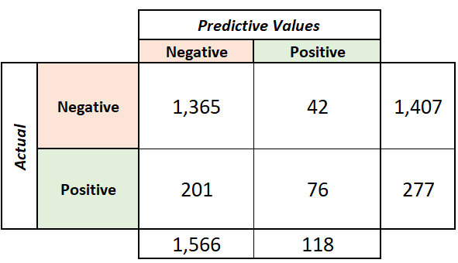
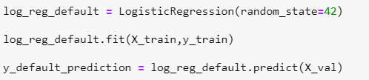
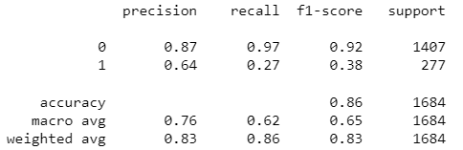
4.a Logistic Regression
3. Firstly we initiate the logistic regression with default parameters.
Precision is a metric that evaluates how many of the predicted positive instances are actually positive.
Recall is a metric that evaluates how many of the actual positive instances are correctly identified by the model.
Due to the nature of our problem, our focus will be on improving precision. We have noticed that our model has a higher precision, meaning it is more confident when it predicts a match, but it struggles to identify all the matches, leading to a low recall score.
The main reason behind this issue is the unbalanced nature of our data. Since we have limited match information, our model is unable to learn effectively.
Notes:
precision: TP / TP + FP
recall: TP / TP + FN
penalty: 'l2'
dual: False
tol: 0.0001
C: 1.0
fit_intercept: True
intercept_scaling: 1
class_weight: None
random_state: None
solver: 'lbfgs'
max_iter: 100
multi_class: 'auto'
verbose: 0
warm_start: False
n_jobs: None
l1_ratio: None

Slide 23
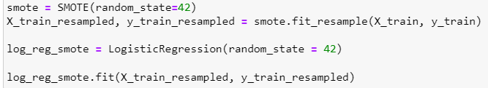
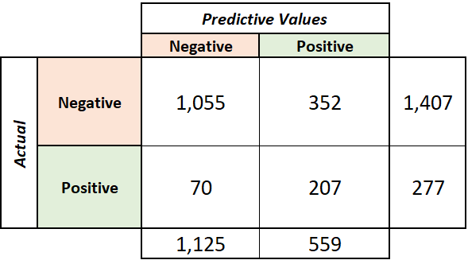
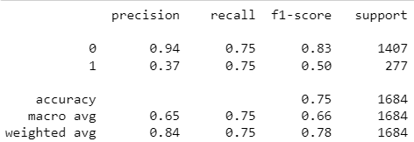
4.a Logistic Regression
4. To fix the unbalanced data issue, we will use a method called as SMOTE. SMOTE, which stands for Synthetic Minority Over-sampling Technique, is a method used to balance the class distribution of a dataset by creating synthetic examples of the minority class.
As we have obtained more match data for our model to learn from, the recall score has improved. However, the model's confidence in finding the correct matches has decreased.
This phenomenon is known as the precision-recall trade-off, whereby improving one metric may cause a decrease in the other.
Going forward, our goal will be to achieve a balance between these two metrics to optimize the model's performance.
Notes:
0 - precision: 0.87 - recall: 0.97
1 - precision: 0.64 - recall: 0.27

Slide 24


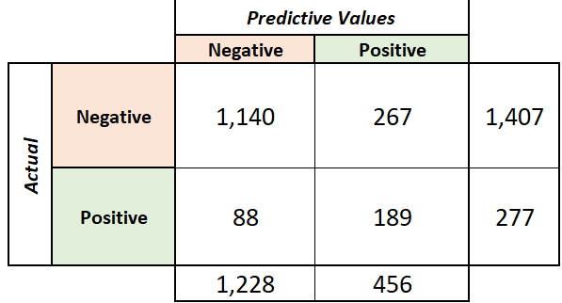
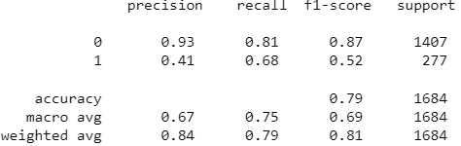
4.a Logistic Regression
5. To improve our model we will use a technique called as grid search cross-validation which is used to fine-tune the hyperparameters of a machine learning model by creating a grid of all possible combinations of those hyperparameters and selecting the combination that produces the best performance on the validation set.
With the help of grid search we managed to increase our precision for match predictions. Since we don’t have large dataset to train, for Logistic Regression, we will accept this.
Notes:
model = LogisticRegression(C=0.3593813663804626, max_iter=1000, random_state=42, solver='newton-cg')

Slide 25

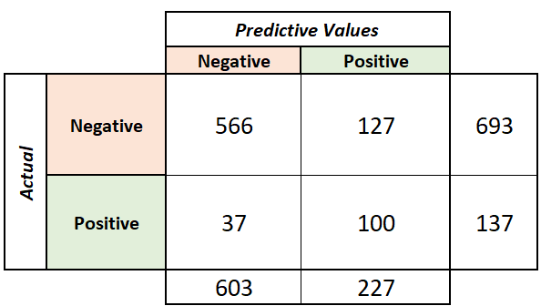
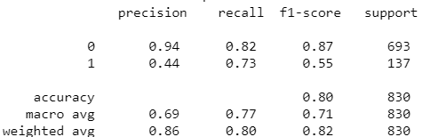
4.a Logistic Regression
5. We have chosen our model, and now we will use cross-validation to evaluate its performance. Cross-validation involves splitting the data into multiple subsets, training the model on some subsets, and testing it on others to estimate how well the model will perform on new data. By doing this and also testing the model on a separate test dataset, we can ensure that our model's results are reliable.
Our model is divided into 5 equal parts. The model is trained on 4 folds and evaluated on the remaining fold, and this process is repeated 5 times so that each fold is used as the validation set exactly once
Our results are similar with our previous scores, so we can say our model is generetable
Final model with the test data
Our final results improved to an acceptable level. Due to our problem nature, we will take these final results for Logistic Regression
Notes:
Make it nice

Slide 26

4.b Random Forest - main concept & steps-
Random Forest is a type of machine learning algorithm that's used for making predictions. It works by creating a "forest" of decision trees. The algorithm then makes predictions for each tree, and the final result is determined by averaging the predictions of all the trees in the forest.
The steps are similar to logistic regression:
We establish the 2 sets, the independents and the dependent variable
Split the sets into test, training and validation group
Notes:
add steps description and some print screen of the code

Slide 27
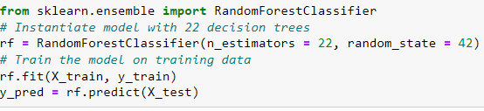
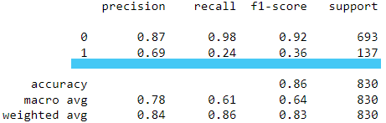
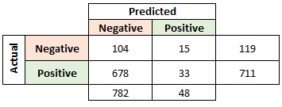
Random forest - the algorithm-
3. We use the scikit-learn library, specifically the RandomForestClassifier class and using all the data we obtained:
Recall is low
Accuracy is high
False negatives are high

Slide 28
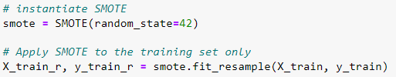
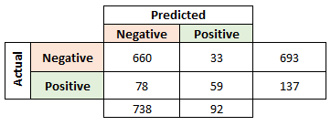
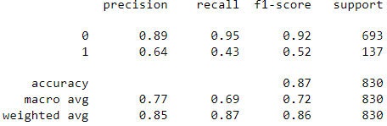
4.b Random Forest - SMOTE-
Create synthetic data using SMOTE. & run the model to find that:
Recall is better,
There are more positives
Is good to use SMOTE
Notes:
add steps description and some print screen of the code

Slide 29
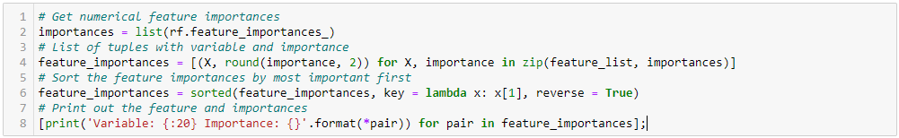
Random forest - Checking importance-
Finally, we assess the significance of each variable in an effort to retain the minimum number of variables.

Slide 30
Random forest -main results-
Variable name | Importance
income | 0.11
int_corr | 0.1
like | 0.09
attr_o | 0.08
pf_o_att | 0.08
like_o | 0.07
attr | 0.07
fun_o | 0.07
shar_o | 0.07
fun | 0.07
prob | 0.07
prob_o | 0.06
shar | 0.06
And after some iterations, we were able to reduce the number of variables from 93 to 35 These variables are:
Income = Median household income.
int_corr= correlation between participant’s interests.
pf_o_att= partner’s stated preference for all 6 attributes.
like , like_o = level of interest in seeing the other person again.
attr, attr_o = rating of attractiveness
Shar, shar_o= shared interest
Fun, fun_o Attribute = related to how enjoyable the other person is
Prob, prob_o = How probable do they think it is that one person will say 'yes'.

Slide 31
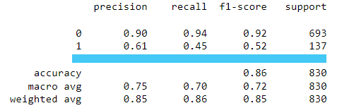
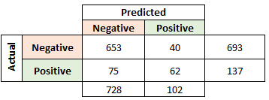
Random forest - results-
Obtaining a better recall.

Slide 32
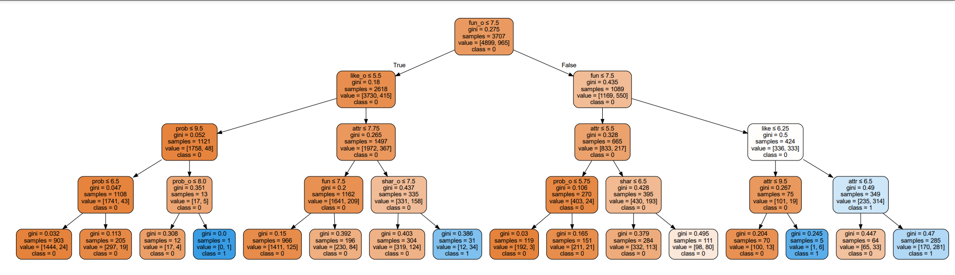
Graphical representation of RF main results.
Graphical representation of any tree in the model is very large, so here we are showing an example of how a tree with 4 levels of depth would look like

Slide 33
Main conclusions after running the Random Forest Model.
Mutual attraction and fun are key factors.
Having similar taste is very important.
Showing interest in seeing each other after the activity.
While income is one of the top variables, its importance is not significantly higher than the other factors, and it is not duplicated like the rest. Therefore, it can be considered as another significant aspect, but not necessarily the most critical one.
Notes:
different models and their acc pres and recall show in a bar and we can compare 3 models
put results for random forest
agree on how to show results

Slide 34
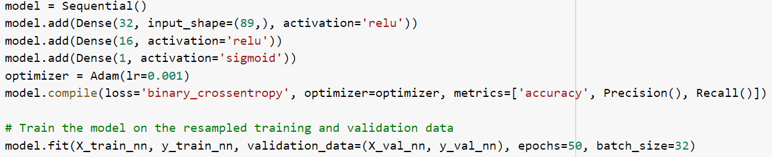
4.c Neural Network
A neural network is a computational model inspired by the structure and function of the human brain, consisting of interconnected nodes, or "neurons", that process and transmit information. For our Neural Network we used Sequential Model. It is a specific type of neural network in which layers are added sequentially, one on top of the other, to form a feedforward network. We used this model because the nature of the model allows for efficient computation and optimization using backpropagation.
We began with a small model, consisting of a small number of layers, utilizing Dense layers where each layer is connected to every node. For our binary classification task, we set our final layer to contain only one neuron with a Sigmoid function.

Slide 35
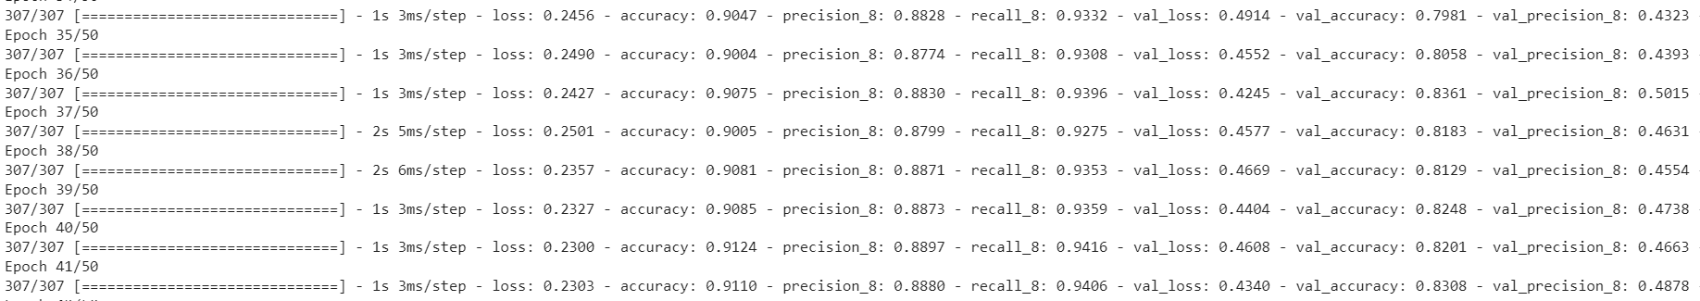
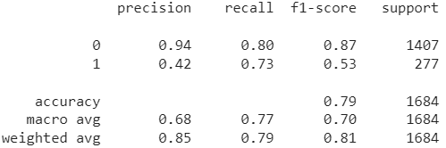
4.c Neural Network
We can see our model is learning and already an acceptable recall and precision for match predictions.

Slide 36
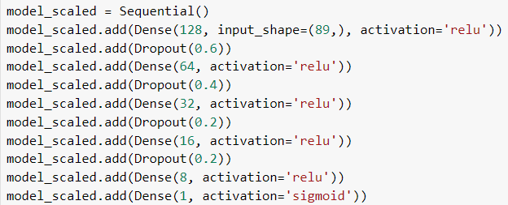
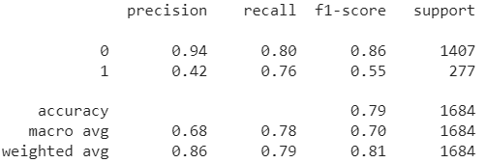
4.c Neural Network
We trained the model again with more layer and nodes. But to prevent overfitting, we used decreasing dropouts.
We used the same compile as the previous model.
As a result, we increased recall by 0.03 but it did not have great improvements in our model.

Slide 37
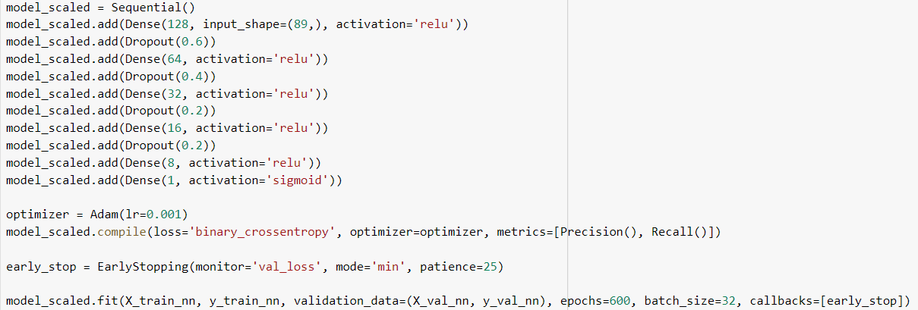
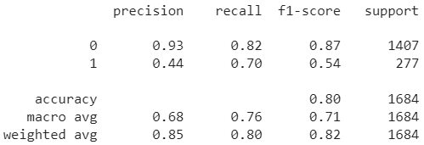
4.c Neural Network
We introduced the early stop to increase epochs but also not to overfit our model. We used the same parameter from the previous model.
As a result, we increased our precision by 0.02 but lost some recall. Still the recall level is acceptable.

Slide 38
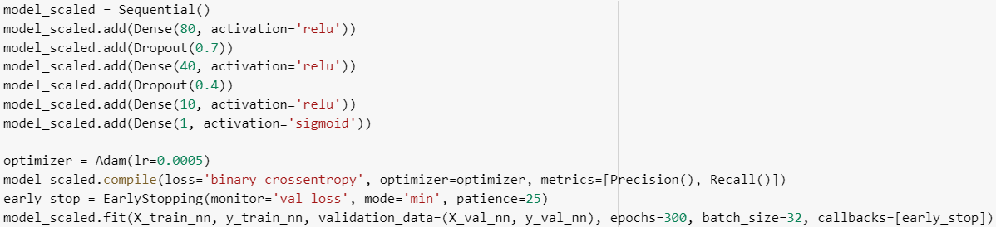


4.c Neural Network
Lastly we tried to decrease our learning rate and decreased nodes number since it didn’t create a difference and we would like to prevent overfitting
Results didn’t change most probably since we don’t have lots of data points our Neural Network model is not learning good.
We ran the model on our test set to see how it is performing with unseen data, the results are acceptable

Slide 39
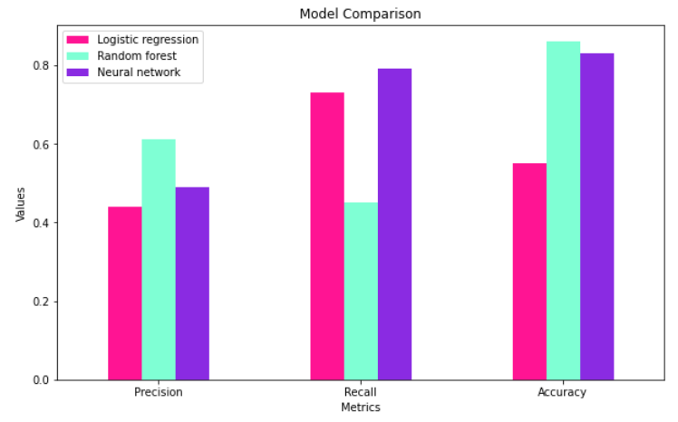
Models comparison
After comparing the errors produced by the models, we determined that the most optimal choice is to use Random Forest. Even though its recall is lower than other models, we think it is more important to find your true love, rather than few bad dates.
However, it is important to note none of the models achieve optimal results, so we would recommend conducting further feature engineering, and collecting more data so our models can learn better.
Notes:
I need the info from neural networks.

Slide 40
5. Conclusion and Further Analysis
According to our models, with this limited data the best model to predict match decision is Random Forest.
As we see from our EDA and the random forest importances, individuals tend to be attracted to people with similar preferences. Although there are some differences between the preferences of women and men, we do not consider them to be significant.
Even though we increased our models performance, it can be further checking with feature engineering and if possible collect more data.
For further analysis, building a recommender engine also be beneficial.
Notes:
built a recommendation

Slide 41
Thank you!

